Slide 1
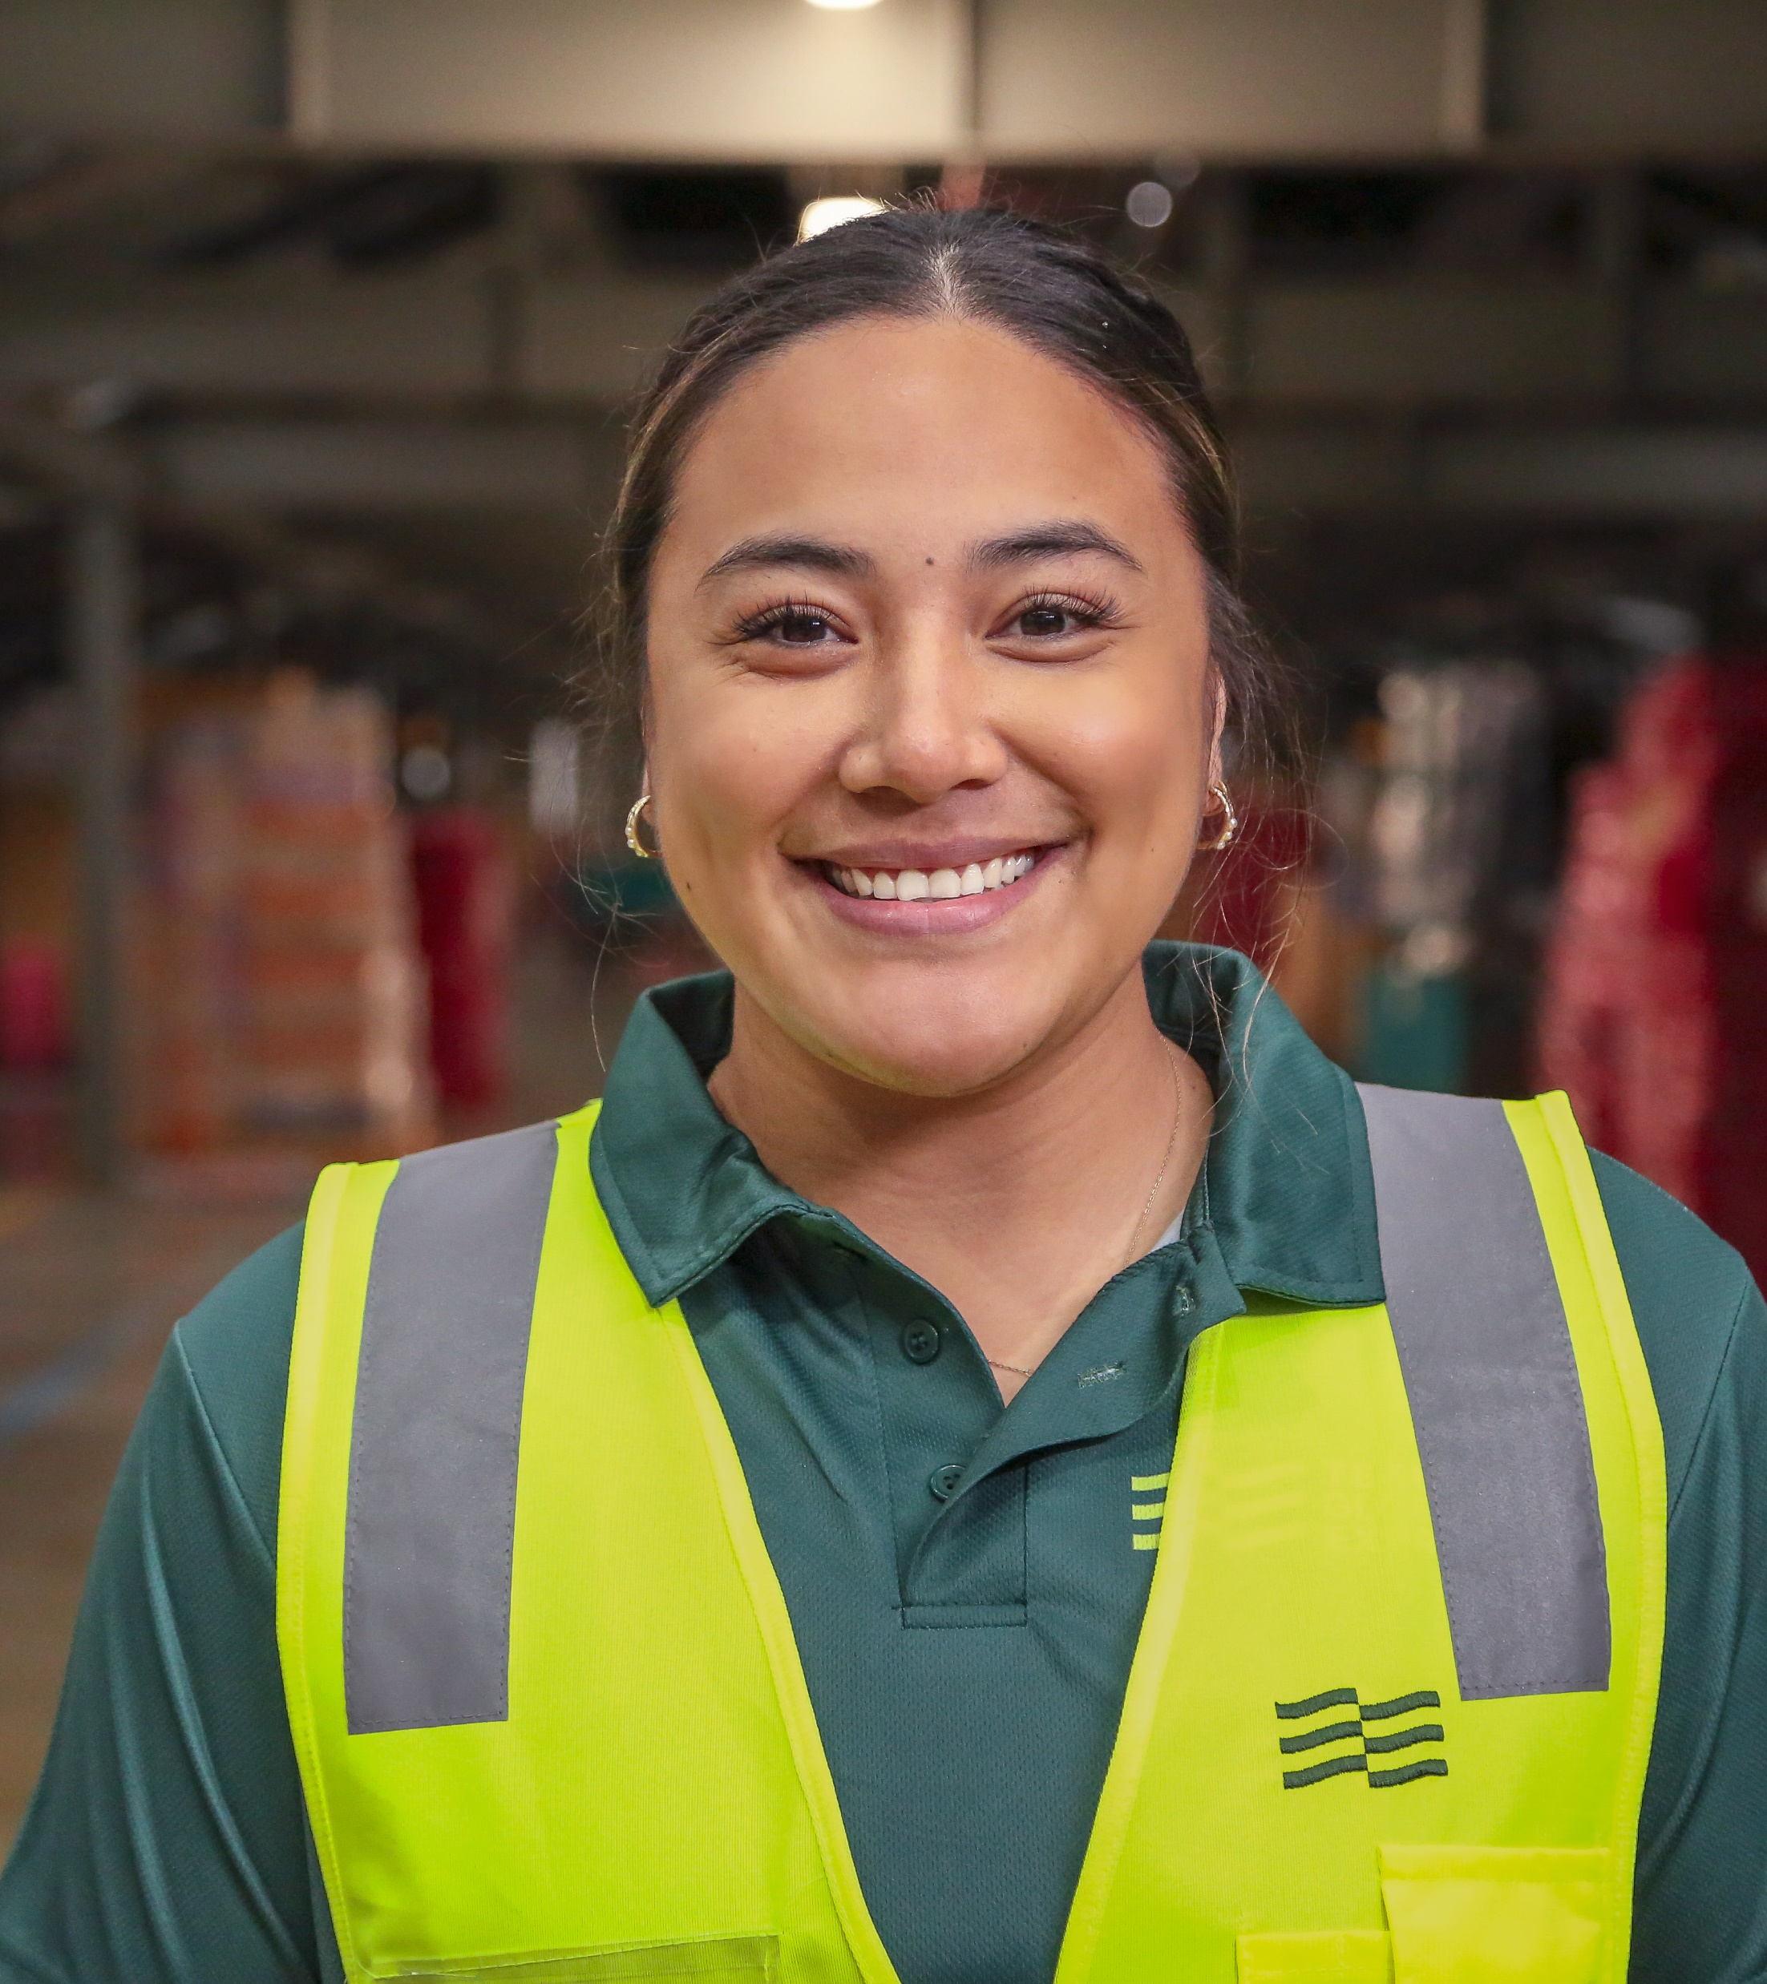
[ Customer Name ] Proposal
[date]

Slide 2










Allegro Funds
Australia’s most awarded and largest transformation and turnaround private equity firm.
Allegro provides Transformational Capital, applying capital, expertise and a distinctly hands-on approach, to invest in businesses and reposition them for sustained long term growth.
Allegro has a strong track record of partnering with management teams and key stakeholders to build better businesses and create enduring value.

Slide 3




Creating value for your business
Team Global Express is fully aligned with [customer name] objectives. Together, we will create better experiences and a better tomorrow for your customers. The combination of our strategic differentiators, our transport assets and our highly skilled and experienced team will deliver high levels of capability, efficiency, performance, and reliability. We look forward to the opportunity to present our solution and discuss how we will work together to bring it to life.
An unrivalled transport network that integrates air and road services in metropolitan, regional and remote locations to leverage the most optimum transport solutions for all industry types.
Industry-specific services and solutions have been executed through our established strong and lasting relationships with key players in a range of industry sectors such as healthcare, retail, industrial, finance, critical spare parts and ICT.
A trusted and ‘safe pair of hands’ in which to entrust your supply chain needs, ensuring seamless end-to-end solutions with a partner equipped to provide best-in-class continuity of service and safety to employees, customers and the general public.
A committed Account Management Team to drive, implement and share initiatives across our suite of services to [customer].
An enhanced IT system providing industry-leading technical innovation by listening to our customers, looking at emerging trends and technology, and investing where it counts.
Continuous Improvement Investment in new technologies, smarter sorting facilities, network expansion which will positively impact on the reliability of our service, safety performance, responsiveness and enhanced customer experience.
Enhanced focus on Sustainability As a leader transport, we are determined to play our part responsibly, meeting the current needs of our communities without compromising the ability of future generations to meet their own needs.

Slide 4

The service you choose depends on:
When you would like it delivered
The cost
The freight type
Any specialised needs
Point to Point Courier
Same Day Intra/Interstate
For a fast delivery
Delivery of documents and parcels through to critical spare parts and medical supplies with 4 delivery time options for adhoc services; regular scheduled runs or taxi trucks for bulk deliveries.
This service is designed to deliver a reliable time critical solution for urgent shipments to any location in Australia.
Delivery by 2pm the next day to all capital cities and major regional centres for documents, satchels, parcels or larger items such as skids and pallets.
Road Freight
Most Cost Effective
Specialised
Express or general service with transit time dependent on distance to travel.
Options for freight to travel by rail or sea, or a combination of these.
Dangerous goods, Returns, High Risk freight, Hand-to-Hand, After Hours, Heavy Haulage, Air Charter and Wharf.

Slide 5
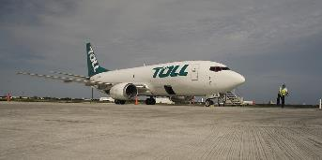
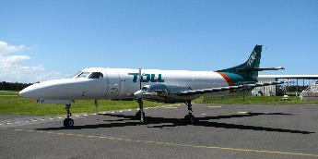
A Reliable & Extensive Network
Light/Medium
Rigid Vehicles
Tray trucks, tilt trays, courier vans, tautliners, tailgate trucks, hiab trucks, pilot and escort vehicles, dry/wet pans, utility vehicles
Boeing 737
Carrying Capacity: 17,000 – 20,000kg
Service routes: Adelaide, Brisbane, Darwin, Melbourne, Perth, Sydney
Heavy Articulated Vehicles
Semi-trailers, flat tops, drop decks, mezzanines, tautliners, tankers (dry, wet and pneumatic), skels, side-tippers, end-tippers, convertible tippers, side-loaders, tipping skels, converter dollies
Light Aircraft
Carrying Capacity: Various
Service routes: Regional locations throughout Australia
Prime Movers &
Multi-Combination Vehicles
Broad range of makes, models and ratings from 42 tonnes – 250 tonnes in A-double, B-double, B-triple, double, AB-triple, triple and quad road train configurations (AAB, BAB, ABB)
40 cargo aircraft
500+ flights a week
Access to the cargo space of commercial airlines
Synchronised integration
with our road network
“
Our network is operated and managed by Team Global Express.
This makes us unique in the transportation and logistics industry as we have full control, visibility and compliance across the network – no matter which service you choose to use.
Specialised Trailers
Deck wideners, low loaders, floats, steerable platform trailers, extendable low loaders/platform trailers, blade trailers, supertilt trailers, steerable jinkers, modular clips
“

Slide 6

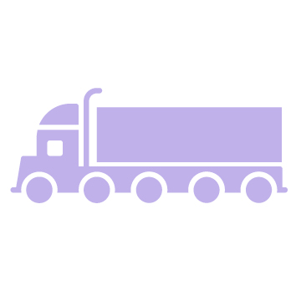

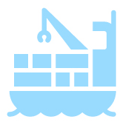
Unrivalled Logistics Network
Australia and New Zealand
Operator of the only independent air cargo network outside of commercial airlines
Thursday Island
Darwin
Nhulunbuy
Weipa
Largest and most far reaching road network supported by strategically located depots
Katherine
Wyndham
Cooktown
Kununurra
Karumba
Cairns
Highest frequency of any rail freight forwarder in Australia
Derby
Halls Creek
Normanton
Innisfail
Atherton
Broome
Fitzroy Crossing
Tennant Creek
Cloncurry
Richmond
Pentland
Ingham
Lucinda
Magnetic Island
Mt. Isa
Ayr
Townsville
Port Hedland
Julia Creek
Mingela
Bowen
Marble Bar
Nullagine
Hughenden
Proserpine
Leading position in key strategic shipping lanes
Karratha
Winton
Dysart
Mackay
Onslow
Pannawonica
Alpha
Exmouth
Paraburdoo
Tom Price
Alice Springs
Longreach
Rockhampton
Newman
Barcaldine
Emerald
Gladstone
Carnarvon
Meekatharra
Monto
Bundaberg
Denham
Wiluna
Charleville
Roma
Maryborough
Quilpie
Gympie
Binnu
Cue
Coober Pedy
Sunshine Coast
Kalbarri
Mount Magnet
Leinster
Cunnamulla
Toowoomba
Brisbane
Geraldton
Mullewa
Laverton
Jamestown
Gold Coast
Carnamah
Eneabba
Morawa
Bencubbin
Leonora
Gawler
Coonabarabran
Inverell
Lismore
Cervantes
Coorow
Latham
Menzies
Ceduna
Bowmans
Bourke
Moree
Grafton
Badgingarra
Calingiri
Kalgoorlie
Port Pirie
Broken Hill
Tamworth
Coffs Harbour
Bodallin
Meckering
Port Augusta
Coonamble
Mudgee
Port Macquarie
Armidale
Perth
Northam
Streaky Bay
Whyalla
Mildura
Nyngan
Dubbo
Taree
Fremantle
Mandurah
Borden
Esperance
Elliston
Clare
Deniliquin
Narromine
Parkes
Newcastle
Orange
Sydney
Bunbury
Bremer Bay
Port Lincoln
Berri
Forbes
Gosford
Bathurst
Busselton
Boxwood Hill
Minlaton
Adelaide
Waikerie
Orange
Wollongong
Cowra
Margaret River
Albany
Mount Barker
Kangaroo Island
Swan Hill
Leeton
Nowra
Canberra
Goulburn
Murray Bridge
Horsham
Shepparton
Hay
Griffith
Albury
Batemans Bay
Wagga Wagga
Balingup
Mount Barker
Naracoorte
Mount Gambier
Bendigo
Benalla
Bega
Cooma
Augusta
Denmark
Hamilton
Colac
Warrnambool
Seymour
Bairnsdale
Warragul
Kerikeri
Legend:
Beverley
Ballarat
Bega
Auckland
Whangarei
Boddington
Geelong
Melbourne
Hamilton
Air
NZ Depots
King Island
Burnie
Launceston
New Plymouth
Rotorua
Devonport
St Helens
Palmerston North
Gisborne
Road
Agents
Ross
Midlands
Hastings
Boyer
Dunalley
Nelson
Masterton
Wellington
Rail
Express Parcel depots
Grove
Hobart
Greymouth
Blenheim
Christchurch
Coastal shipping
Cromwell
Ashburton
Palletised Express /Intermodal & Specialised depots
Queenstown
Timaru
Major depots
Oamaru
Invercargill
Dunedin

Slide 7
Unrivalled Logistics Network
Australia
Operator of the only independent air cargo network outside of commercial airlines
Thursday Island
Darwin
Nhulunbuy
Weipa
Largest and most far reaching road network supported by strategically located depots
Katherine
Wyndham
Cooktown
Kununurra
Karumba
Cairns
Highest frequency of any rail freight forwarder in Australia
Derby
Halls Creek
Normanton
Innisfail
Atherton
Broome
Fitzroy Crossing
Tennant Creek
Cloncurry
Richmond
Pentland
Ingham
Lucinda
Magnetic Island
Mt. Isa
Ayr
Townsville
Port Hedland
Julia Creek
Mingela
Bowen
Leading position in key strategic shipping lanes
Marble Bar
Nullagine
Hughenden
Proserpine
Karratha
Winton
Dysart
Mackay
Onslow
Pannawonica
Alpha
Exmouth
Paraburdoo
Tom Price
Alice Springs
Longreach
Rockhampton
Newman
Barcaldine
Emerald
Gladstone
Carnarvon
Meekatharra
Monto
Bundaberg
Denham
Wiluna
Charleville
Roma
Maryborough
Quilpie
Gympie
Binnu
Cue
Coober Pedy
Sunshine Coast
Kalbarri
Mount Magnet
Leinster
Cunnamulla
Toowoomba
Brisbane
Geraldton
Mullewa
Laverton
Jamestown
Gold Coast
Carnamah
Eneabba
Morawa
Bencubbin
Leonora
Gawler
Coonabarabran
Inverell
Lismore
Cervantes
Coorow
Latham
Menzies
Ceduna
Bowmans
Bourke
Moree
Grafton
Badgingarra
Calingiri
Kalgoorlie
Port Pirie
Broken Hill
Tamworth
Coffs Harbour
Bodallin
Meckering
Port Augusta
Coonamble
Mudgee
Port Macquarie
Armidale
Perth
Northam
Streaky Bay
Whyalla
Mildura
Nyngan
Dubbo
Taree
Fremantle
Mandurah
Borden
Esperance
Elliston
Clare
Deniliquin
Narromine
Parkes
Newcastle
Orange
Sydney
Bunbury
Bremer Bay
Port Lincoln
Berri
Forbes
Gosford
Bathurst
Busselton
Boxwood Hill
Minlaton
Adelaide
Waikerie
Orange
Cowra
Margaret River
Albany
Mount Barker
Kangaroo Island
Swan Hill
Leeton
Nowra
Canberra
Goulburn
Wollongong
Murray Bridge
Horsham
Shepparton
Hay
Griffith
Albury
Batemans Bay
Wagga Wagga
Balingup
Mount Barker
Naracoorte
Mount Gambier
Bendigo
Benalla
Bega
Cooma
Legend:
Augusta
Denmark
Hamilton
Colac
Seymour
Warragul
Beverley
Warrnambool
Bega
Bairnsdale
Air
Agents
Boddington
Ballarat
Geelong
Melbourne
Road
Express Parcel depots
King Island
Burnie
Launceston
Rail
Devonport
St Helens
Midlands
Palletised Express /Intermodal & Specialised depots
Boyer
Ross
Coastal shipping
Grove
Dunalley
Major depots
Hobart

Slide 8
Our National Network
Rail
Darwin
Cairns
Innisfail
Townsville
Bowen
Mackay
Rockhampton
Brisbane
Perth
Adelaide
Sydney
Legend:
Melbourne
Rail
Intermodal depots
Major depots

Slide 9
Our National Network
Sea
Darwin
Cairns
Innisfail
Townsville
Bowen
Mackay
Rockhampton
Brisbane
Perth
Adelaide
Sydney
Legend:
Melbourne
Sea
Intermodal depots
Burnie
Major depots

Slide 10
Why Companies rely on our Industry-Focused Solutions
For more than 133 years, Team Global Express has provided services for customers regardless of the volume of freight they move. Strong and lasting relationships have been established, enabling us to develop our capabilities to include industry-specific expertise, services and solutions.
Automotive & Industrial
Chemical & Agriculture
ICT
Retail & FMCG
Multiple service options are available for the complex, cost-driven nature of the automotive sector, we have developed cost-effective, industry supply chain and distribution solutions. Time-critical spare parts components are delivered to the dealer network where and when needed, within short timeframes.
Efficient, compliant and transparent suite of logistics services have been developed, including end-to-end supply chain management to deliver the specialised solutions that chemical and agribusiness needs. Delivery capability to capital cities, regional and remote locations.
Customised solutions have been developed that improve speed to market, reduce operating costs and manage inventory levels more effectively. Heightened security measures are in place with full visibility of the supply chain and customised value-added services.
Our customers require a partner who understands the dynamic nature of the retail and FMCG industry to ensure stock arrives in perfect condition, ready for sale. We deliver DC to DC, direct to shopping centres, store to store transfers, including time slot deliveries.
eCommerce
Mining & Resources
Healthcare & Well-being
Government & Defence
eCommerce delivery solutions offer customers speed, convenience TGE Collection Points for delivery, afterhours collection or return. Delivery pre-alerts and tracking with simplified notifications via our digital platform.
Stand-alone and integrated services are provided to the mining and resources sector across inbound, onsite services, off-site retrievals and outbound segments of the mining logistics supply chain. Delivery is direct to remote mine sites and compliant with Site Rules and Chain of Responsibility.
Due to the sensitive nature of medical equipment, pharmaceuticals, pathological specimens and vitamins, industry specific initiatives and services have been designed for the safe delivery of products to ‘patients on table’, hospitals, medical clinics, pharmacies and wholesalers.
All aspects of our supply chain are compliant with legislative requirements and governed by strict security, operational and safety management frameworks. Services are suitable for distributing National Security Classified Material, up to and including Top Secret.

Slide 11
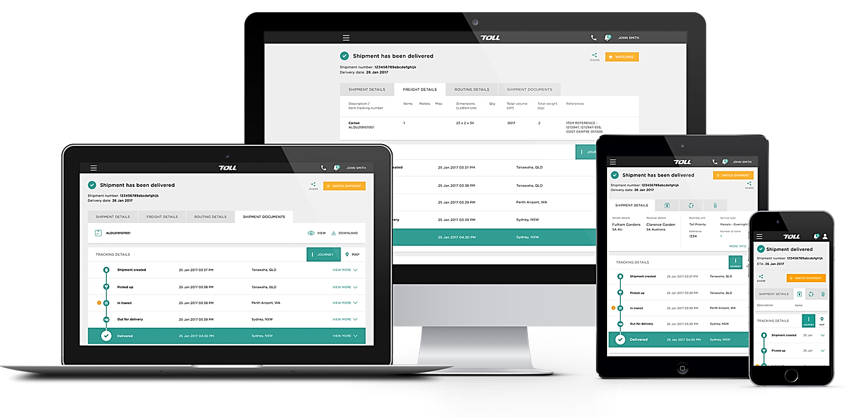



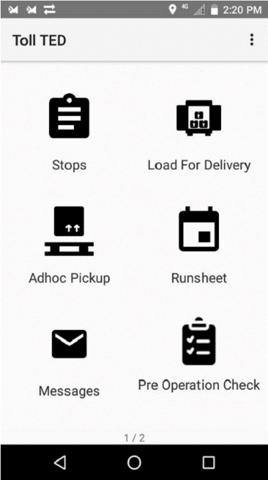
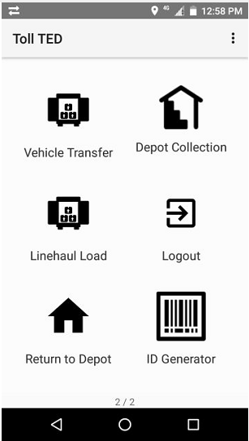
Providing Improved Customer Experience
A$50m investment
A single, global, digital ordering & tracking experience for our customers
Benefits
Standardised digital customer experience
One-stop solution for booking needs
Track and trace / Real-time alerts
AWS cloud managed infrastructure
Resiliency implemented across MyTeamGE
DASHBOARDS
MyTeamGE
FINANCE
ACCOUNT MANAGEMENT
500k+ users
1.8m+ bookings p/m
10m+ T&T searches p/m
STATIONERY
SHIPMENTS
MyTeamGE
TRACK & TRACE
RATE & TRANSIT TIME ENQUIRIES
A$45m investment
Single scanner solution for drivers and depot staff, running a standard data driven application to pickup and deliver items.
Benefits
Team Global Express’ new scanning device, TED
Multi-purpose single scanner solution for drivers and depot staff
Provides real-time shipment and delivery events to MyTeamGE
Giving customers an end-to-end view of their freight as it moves through the Team Global Express network.
DRIVER APPS
MANIFEST MANAGEMENT
PICKUPS
RETURNS
9000+ Global Express’ drivers & users

Slide 12
Team Global Express Electronic Delivery Application
Team Global Express Electronic Delivery Application is a multi-purpose single scanner solution for drivers and depot staff to manage pick-ups, deliveries, associated event milestones in addition to operational and safety checks.
Key Application Features
Improved customer experience by using a single MDT to deliver all Team Global Express freight
Reduction of paper-based consignment management/ proof of delivery notifications
Improved customer visibility of tracking information as items are processed
A single scanner solution and application across all our businesses
Single process for pickup and delivery of products irrespective of business unit with a single device
Customer only signs once for cross-business unit deliveries
Ability to track freight to authenticated drivers
Automate depot arrival and depart recording/geo-fencing of Team Global Express and non-Team Global Express locations
Manage jobs
Load deliveries
Transferring freight
Depot pickups
Driver initiated pickups
Record daily events
Linehaul functionality
End shift
Communications from depot
Pre- operational safety check
Transfer undelivered freight
ID’s for freight transfers

Slide 13
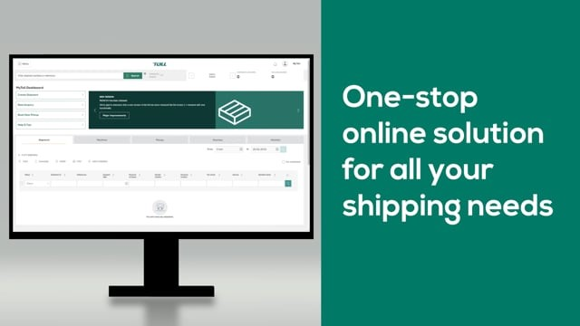
MyTeamGE Services
MyTeamGE is our Team Global Express global digital platform, a one-stop solution for all your shipment needs.
A simple and easy to use application with help & tips to help you along the way.
Dashboards
Track & Trace & POD
Account Management
Create and monitor shipping transactions and receive communications about news updates, system announcements and new MyTeamGE functionality from a central location.
Track multiple shipments on any device and get real-time visibility of the shipment status
View and download proof of delivery and alternate shipment collection points for missed deliveries
Configure and save default settings for increased efficiency when creating transactions .
Save frequently used information to reduce repetitive data entry, improving transaction speed and accuracy.
Shipments
Manifest Management
Stationary & Finance
Create shipments including Specialised transport shipments or international shipments.
Print labels, consignment notes and commercial invoices quickly and conveniently directly from MyTeamGE
Create & add shipments to a new or existing manifest.
Print shipping documents from within the manifest
Close manifest to submit shipment information to TGE carrier systems
Order a range of TGE Priority products such as labels, stickers, satchels directly on MyTeamGE.
View, search and download individual invoices.
Pay individual invoices online.
Pickup/Booking
Returns
Rate & Transit Enquiries
Take a closer look and watch the above video
or watch in full screen here
Save time by booking a pickup via MyTeamGE.
Create & save booking templates.
Book pickup directly from shipment manifest or book a single request for shipments not created on the MyTeamGE application.
Create and submit a return shipment with TGE Priority in MyTeamGE
Track the shipment through to delivery
Calculate cost and delivery time frames for shipping items with an approved TGE carrier and service.
MyTeamGE
13

Slide 14
MyTeamGE Integration Platform
Our enterprise integration capability via MyTeamGE and support for industry standard messaging, offers integration in a consistent and secure manner within a short timeframe.
Integration Capability
Enterprise Application Integration
Team Global Express’ primary method of integration is via the MyTeamGE APIs.
These APIs conform to one messaging standard referred to as Team Global Express Message and can be used across all Team Global Express Business Units.
Build fast, easy-to-implement integration solutions based on industry standards including GS1
High availability and disaster recovery enabled via Australian data center hosting
Reduce manual and labor-intensive paper- based processes
A feature-rich webMethods suite to enhance new B2B initiatives
A dedicated team of integration specialists to develop and support the platform
Print API
Pricing/Rate API
Returns API
POD & Photo Image API
CUSTOMERS
Shipment/manifest API
Track & trace API
Proof of delivery API
Pick-up API
PARTNERS
SUPPLIERS
TRANSPORT
3PLS
MyTeamGE
Integrating with MyTeamGE Platform
The MyTeamGE platform enables information exchange between Team Global Express’ systems and external parties via API.
Typical preferred communication protocols are:
HTTPS, SFTP
Typical messaging standards:
XML, JSON
Certificate Protocols:
We Support TLS 1.1 and 1.2 Protocol
CUSTOMS
BROKERS
WAREHOUSES
FREIGHT
FORWARDERS
SERVICE
PROVIDERS
CARRIERS
Technical integration specification
Customer Onboarding Specifications

Slide 15







MyTeamGE Consigning Options
MyTeamGE offers 4 options to create shipments “Making life easy & fast” for our customers.
MyTeamGE User Interface
MyTeamGE Shipment API
The MyTeamGE user interface is a simple and easy to use application, allowing customers to quickly and seamlessly create shipments.
On offer is a range of API’s, including our MyTeamGE Shipment/Manifest API, providing a simple, fast and intelligent integration solution.
Create & save commonly used item templates
Create & save commonly used references
Create and save sender & receiver contacts
Pre-set commonly used carrier and services
Access to Label & associated documents
Customise printing preferences
Common message formats for all GE carriers
Choose between Json or XML message formats
Secure communication via HTTPS protocol
API success and error handling responses
Supporting TLS 1.1 and 1.2 certificate protocols
Bulk Create Shipments
my
TeamGE
MyTeamGE Auto Importing
my
TeamGE
MyTeamGE’s fixed xls or xlsx format saves customers time, allowing users the ability to easily upload a bulk list of shipments within a few quick steps via the MyTeamGE user interface.
MyTeamGE users can easily auto import shipments directly from their WMS/FMS systems to the MyTeamGE User interface, via a quick and easy API call request.
Fixed xls & xlsx format
Easily upload files from a local or shared network location
Shipment Consolidation preferences
Easily manage file errors
Customise Bulk Create settings at a user level
Automated Printing available
Preferred: CSV file header format
Import directly from your WMS or FMS via HTTPS using Curl script
API responses to easily manage both success and error responses
Set shipment default values such as carrier, service and account#
Manage (edit or view) import data via the MyTeamGE user interface
Automated printing available
15

Slide 16
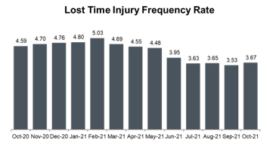
Safety-First Culture
We believe that everyone has the right to return home safely.
We are working towards creating a workplace free of incidents and injuries.
We operate in a high-risk industry
Team Global Express vs industry benchmark
We are safety obsessed
Transport, Postal and Warehousing Industry in Australia
Lost Time Injury Frequency Rate
(LTIFR)
Our focus areas
Safety-first mindset
Global Safety Obsessed workshops empower our people to speak up, and care for each other
8.1
2nd
Highest no. of fatalities
39 per year (20% of total)
Transport, Postal and Warehousing
Industry Benchmark
Stringent safety reporting
One central platform for safety reporting, analytics and insights. This enables us to do better and understand, manage and improve the health and safety of our people
1st
Highest fatality rate
15.6 deaths per 100,000
1st
Highest frequency rate
11.0 per million hours worked
Preventative technologies
AUD$2 billion investment in fleet and equipment globally to improve safety and efficiency (including telematics, driver app, etc.)
*LTI data used is from TGE’s incident reporting system. TGE LTI and hours worked data have been entered in the Worksafe Australia comparison tool (https://www.safeworkaustralia.gov.au/statistics-and-research/lost-time-injury-frequency-rates-ltifr). The TGEl figures are accurate at the time of reporting.
Source: www.safeworkaustralia.gov.au/system/files/documents/1807/road-transport-priority-industry-snapshot-2018.pdf

Slide 17













ESG at a Glance
Team Global Express’s key sustainability Programs
We are committed to being a leader in ESG. This requires the identification and implementation of key ESG initiatives to deliver improved environmental performance, risk reduction, and operating economics. We plan to achieve this through continuous improvement programs along with specific, program-based campaigns.
Smarter Driver
Vehicle Specific Driver training to achieve better efficiency
Telematics used to report results to the driver
Smarter Facilities
Environmental Sustainability Design (ESD) becomes standard for new facilities.
LED/Solar on facilities.
Environment
Social
Governance
Environment Management system
GHG reduction
Sustainable packaging
Waste management
Energy efficiency
Indigenous engagement
Human rights and community engagement
Diversity and inclusion
Workplace health and safety
Modern slavery and anti-human trafficking
Anti-bribery and corruption
Anti-competitive practices
Improved supplier due diligence
Smarter Vehicles
Energy Efficiency included in all vehicle specifications
Beyond standard aerodynamics
Low Rolling Resistance (LRR) tires standard issue
Weight reduction
Smarter Fuels
Where feasible Biodiesel blends to be used
Work with Original Equipment Manufactures on next gen Electric Vehicles (EVs)
Continue to monitor and assess alternative fuels (Hydrogen, SAF etc)
Smarter Planning
Route and Network Optimisation
Use of Higher Productivity Vehicles
Strategic partnerships with customers to improve ESG performance
“
We promise to become the people that deliver beyond.
For our customers, environment, and the communities around us.
“

Slide 18



Supporting you through the journey
Operations
Onboarding
The Operations team will assist with casual or permanent collections and identify areas to improve DIFOT performance
You will be supported by a Team Global Express representative to assist with the credit application process through to commencing trade
Account Management
Accounts Receivable
Our team will assist with any questions you may have and to offer recommendations to improve your supply chain processes
Client
To resolve any invoice related enquiries and credit requests
eTrade
Customer Service
Experienced I.T. team to support clients online experience via phone or email
The teams are available to manage enquiries that can't be resolved through MyTeamGE, our web-based application that provides real time, item level tracking and PoD retrieval

Slide 19



Next Steps
STEP 1
STEP 2
STEP 3
STEP 4
STEP 5
Agree to do business together
Proposal Acceptance
Account set-up
Operational & IT readiness
Commence trade
Service solution & rate proposal presented for review
Proposal sign off obtained
Credit application processed
Billing account number set-up
MyTeamGE registration processed
Product ordering fulfilled
Site safety inspections completed
Collections & vehicle allocations scheduled
IT integration/MyTeamGE onboarding completed
First collection completed
First invoice received

Slide 20

tgexpress.com.au
[ TGE Sales person's name ] | [ Title ]
[ email address ] | [ mobile number ]

